Slide 1
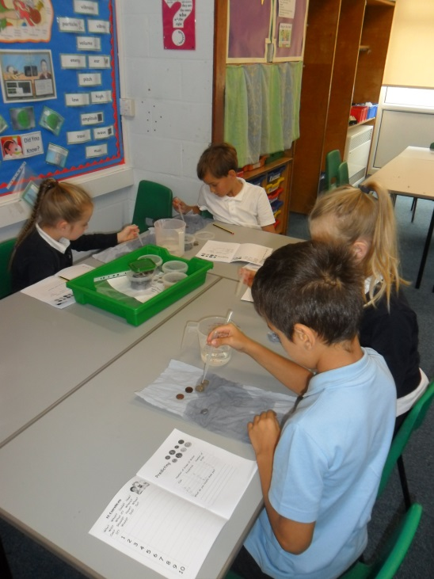
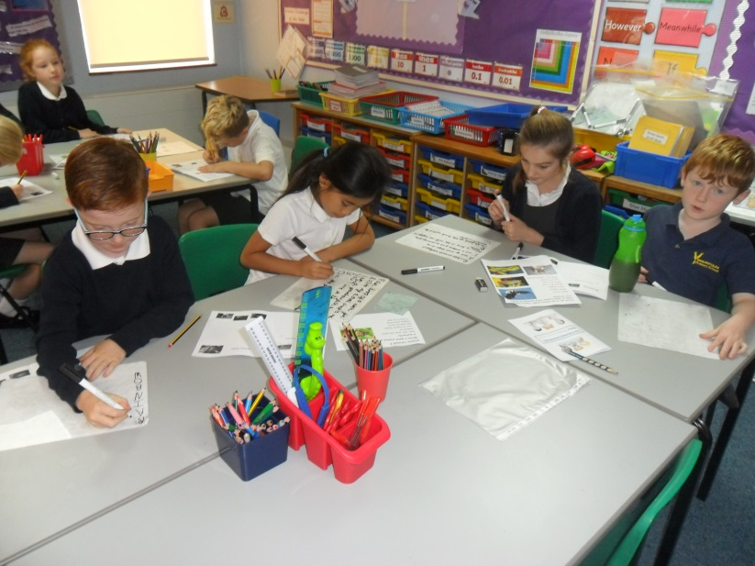
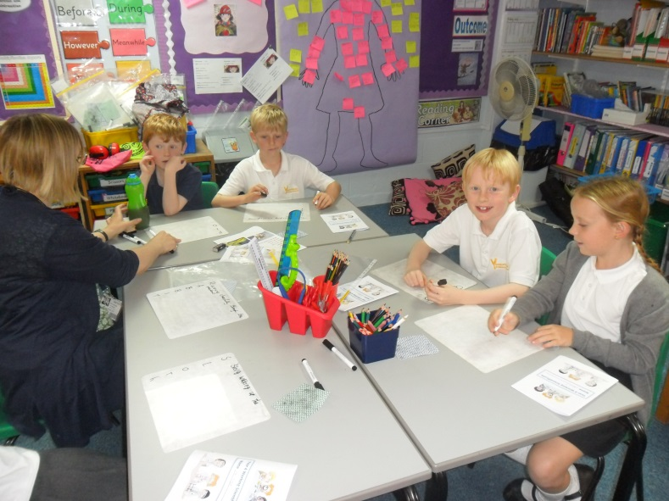
Year 4 Welcome Meeting

Slide 2
The Year 4 Team
Class 9 Miss Hammond
Class 10 Mrs Tudor
L.S.A.s Mrs Matthews, Mrs Carpenter, Mrs Perry, Dr McCabe and Mrs Davis

Slide 3
The Curriculum
Autumn – The Lost Happy Endings and Father Christmas , Sound, Europe
Spring – States of Matter, The Vikings and Viking Science
Summer – Iron Man, Tuesday, Forces, Habitats and Electricity

Slide 4
Reading
Reading at home
Reading Diaries
Visiting school library

Slide 5
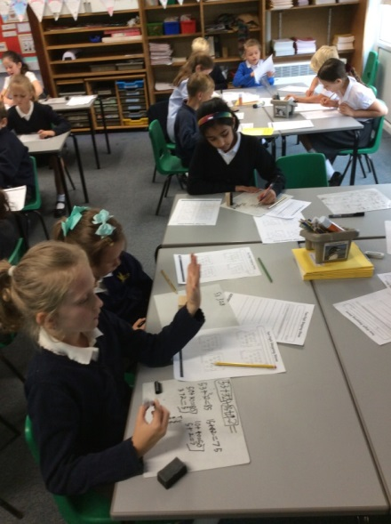
Maths
The importance of learning multiplication tables and number bonds
Abacus Scheme and homework
Login: 4 letters surname 4 letters first name
Password – maths2014
3mja

Slide 6
Spellings
High frequency words to learn at home
Spellings to learn at home taken directly from Y4 Curriculum
Weekly tests
Words of the week

Slide 7
Handwriting

Slide 8
Home Learning
Maths weekly set on a Friday and to be completed by Thursday (pencil)
Spelling homework given out Monday and tested the following Monday
Homework Menu
In addition reading and
multiplication tables/division practice

Slide 9
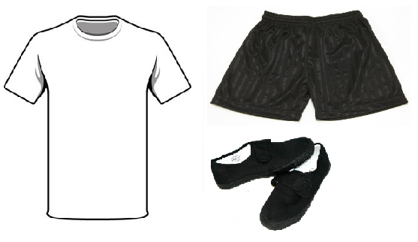
Uniform and Sports Kit
Games – Tuesdays and Wednesdays
Suitable kit
No jewellery
Change of shoes
Hair tied back

Slide 10
Behaviour
Our Golden Rules
Reward Systems
Golden Time

Slide 11
The 4 Rs Being Independent Learners
Resilience
Resourcefulness
Reflectiveness
Reciprocity

Slide 12
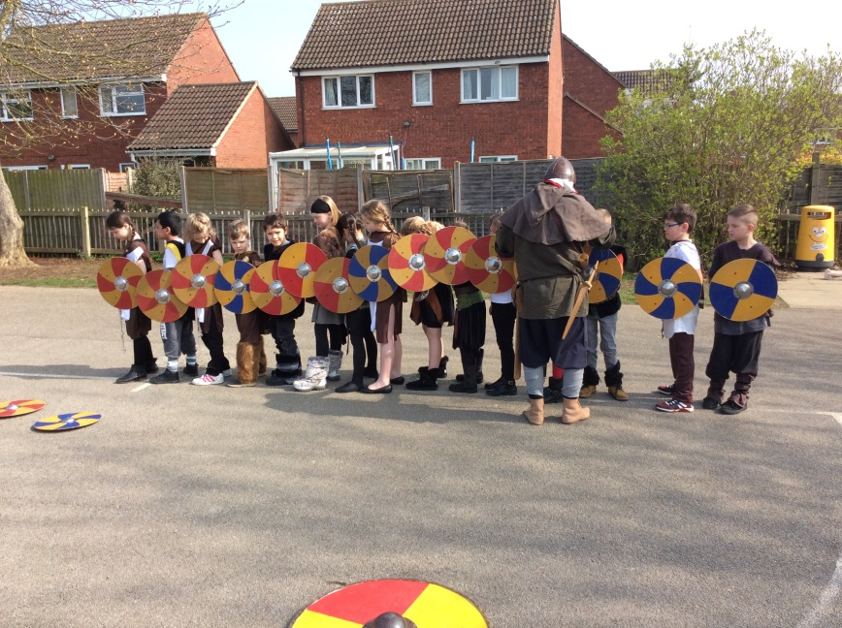
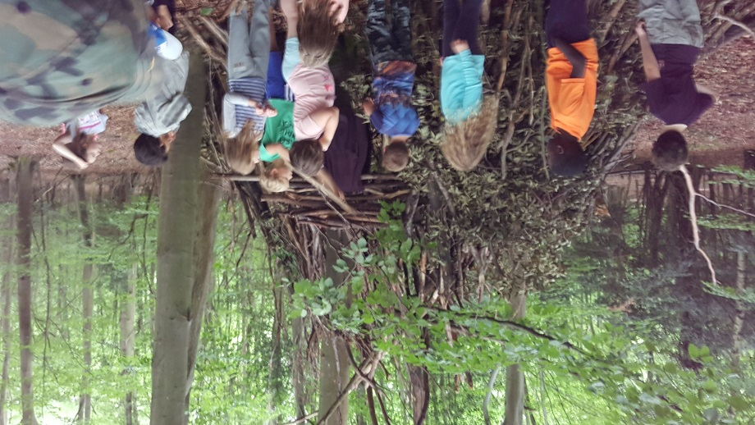
Trips and Visits
Thorpe Woodlands
Viking Day

