Slide 1
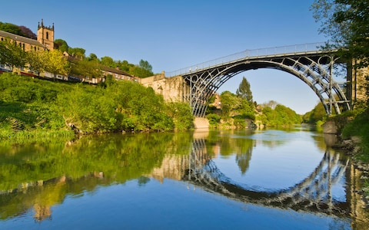
Year 6 Ironbridge Residential

Slide 2
Staff
Miss Elliott
Miss Keane
Mr Sanderson
Mrs Buck
Miss Vickers

Slide 3
Day 1 – Monday 1st October
Arrive at 08:30 and head to Hall with suitcases
Register
Medicine - give to Miss Keane
Check medicine is in date
Inhalers x 2 (one for child, spare for group adult)
Letters / Bday cards - hand to Mr Sanderson
Sweets – individually wrapped and put in box to share

Slide 4
Youth Hostel
We are the only school staying at Coalbrookedale Youth Hostel
Weekly key codes on all outside doors – only YH staff and teachers know
Staff on site 24/7 – teachers have walkie-talkies / bell at reception
Rooms
Decided by teaching staff – children find out at CYH
Rooms on two storeys – 2 teachers on each floor
Most rooms en-suite

Slide 5
Youth Hostel & Food
On arrival, children make own beds!
No bedding is needed but children will need towels.
Meals
Evening meal is 3 courses (pre-ordered)
Vegetarian option available – please let us know of dietary requirements/ recent changes in diet
Breakfast – full English/toast/cereal/fruit/yoghurts
Packed lunch everyday includes: sandwich, crisps, cake/cereal bar, fruit, bottle of water (pre-ordered)

Slide 6
Itinerary
Monday: Boat trip
Arrive at Coalbrookedale Youth Hostel & unpack
Team building activities
Tuesday: am - Walk to Enginuity for Buggy workshop
pm – Museum of the Gorge
Wednesday: Blist Hill Victorian Town, Ironbridge (candle dipping, make a brick)
Thursday: Park Hall Farm, Oswestry (pig racing, pony grooming, milking cows)
Friday: am – Jackfield Tile Museum (tile decorating)
pm – leave Ironbridge at 1.00 pm to arrive home for 4.00-4.30pm.

Slide 7
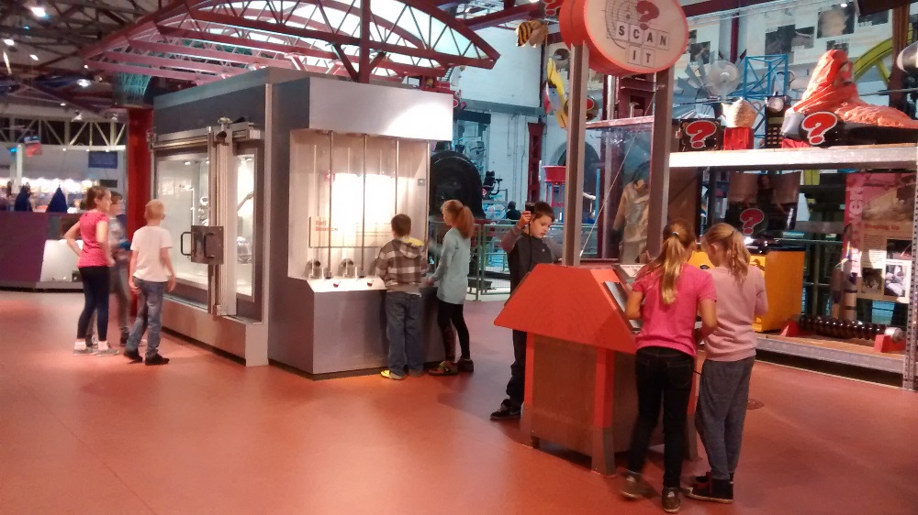
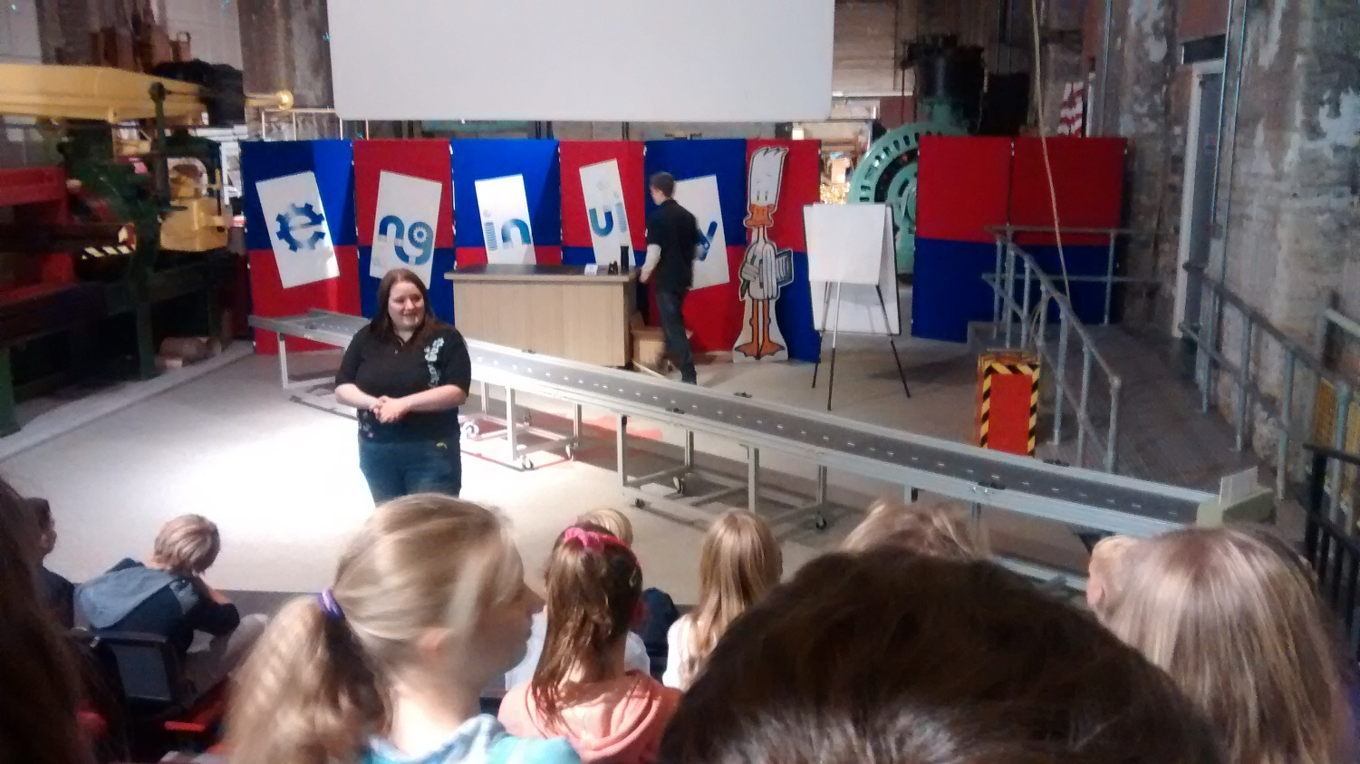
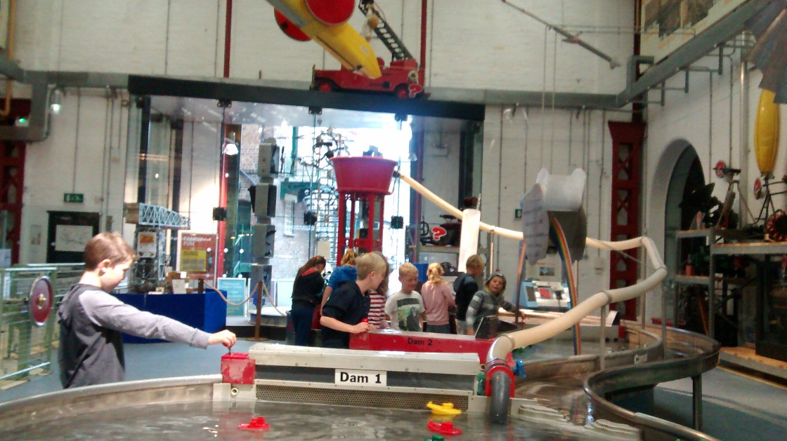
Tuesday – Enginuity & Museum of the Gorge

Slide 8
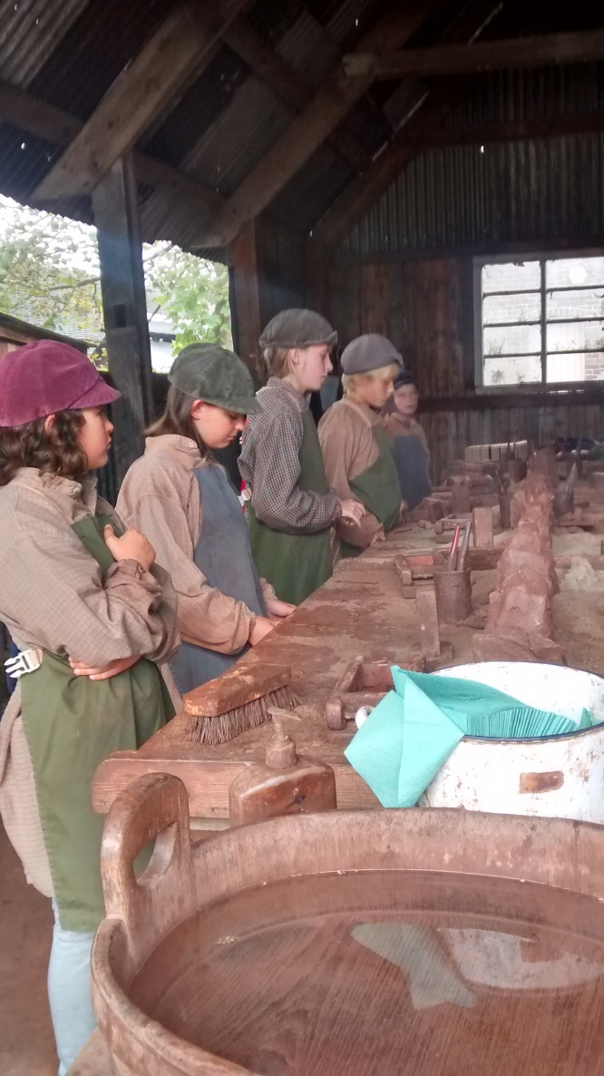
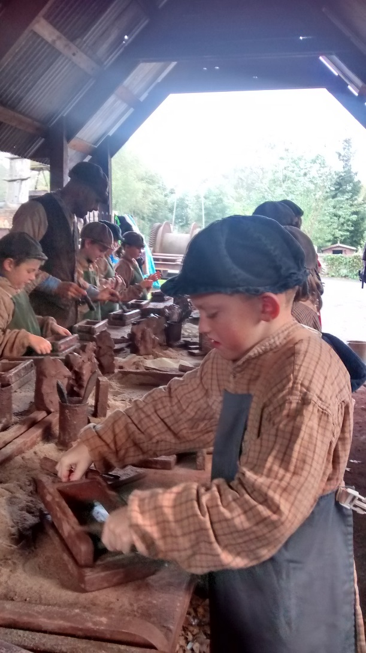
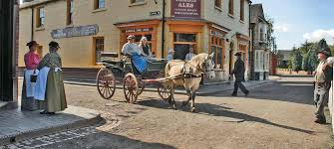
Wednesday – Blist Hill Victorian Town (Brick making, candle dipping)

Slide 9
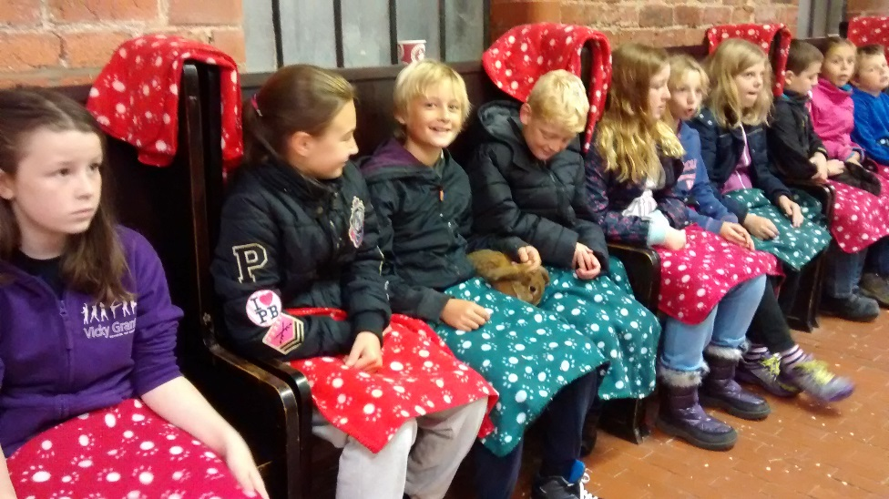
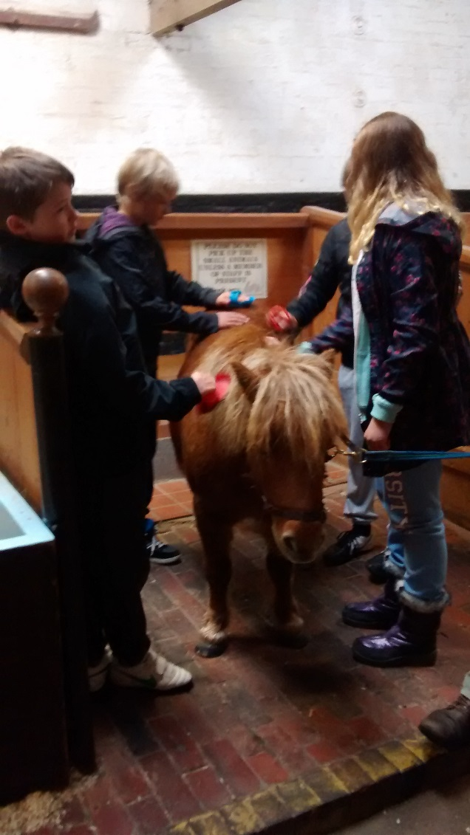
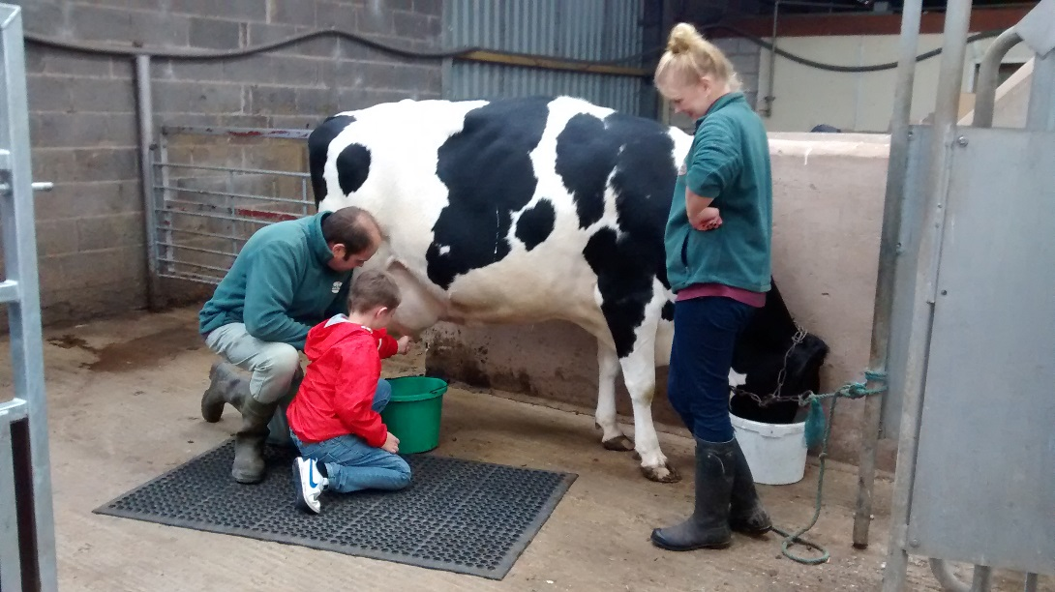
Thursday – Park Hall Farm

Slide 10
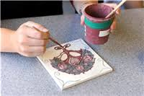
Friday – Jackfield Tile Museum & home!

Slide 11
Friday 5th October
Leave Jackfield Tile Museum at 1.00pm
Staff will telephone school when we leave and when we are 1 hour away
Should arrive back at Wheatfields for 4.00-4.30pm (depending on Friday traffic!)

Slide 12
Extras
No mobile phones
No electrical games
Remind children not to lend money to friends
ONLY disposable cameras – we will take school cameras and produce slideshow or CD when back at school
Keep suitcases small –numerous flights of stairs to climb to rooms
Pocket money – this is included within the cost of the trip and all children will receive the same amount. Please do not send any extra – we will look after it and return it when we get back to school. Please bring a purse / wallet.
Please bring:
spare shoes waterproof jacket water bottle
back pack dirty washing bag

Slide 13
Code of Conduct
There is an additional letter for you to sign that says that you agree to collect your child from the residential (if they are contacted by staff who are concerned about their behaviour and safety).
Polite Reminder
Please return the following ASAP:
Consent and Medical/Dietary Information form
Pupil Data form

