Slide 1


Welcome to
ASH AND BEECH Class
Curriculum Meeting
September 2026

Slide 2
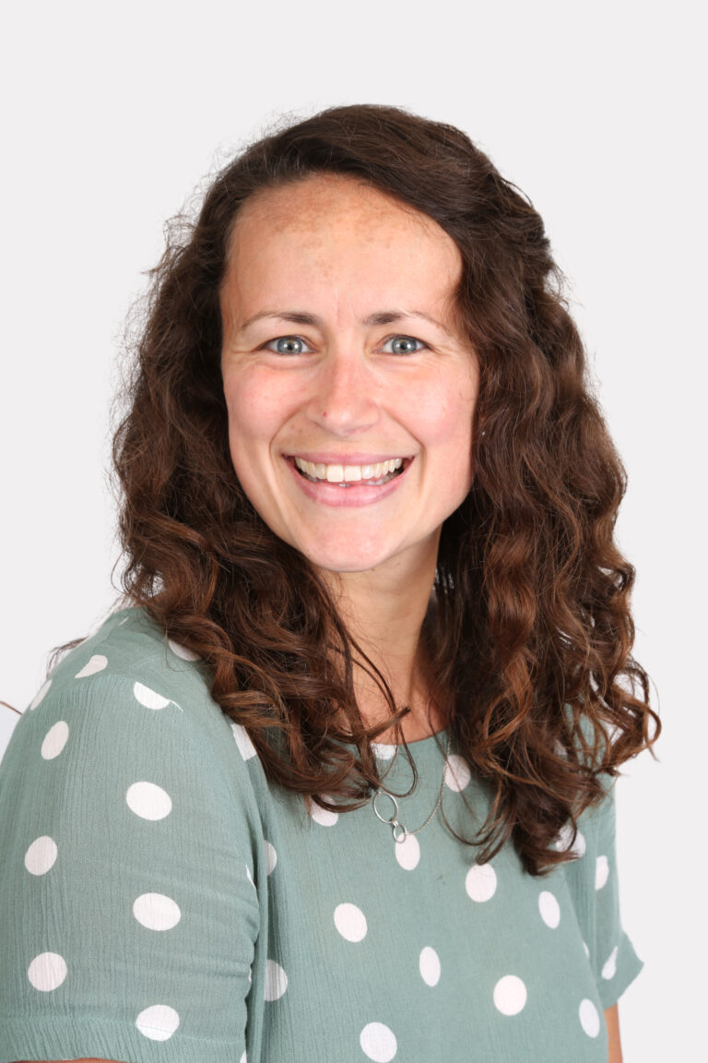



Meet the team
Mrs Todd
Mrs Tierney
Mrs Smith
Miss Marney
Mrs Webb
Mrs Hill
Mrs Nekkanti
Mrs Mallon
Mrs Moore
Notes:
KT

Slide 3
Our CURRICULUM:
Early Years Foundation Stage
National Curriculum- Key Stage 1
Notes:
NJ- emphasize we teach both curriculums.

Slide 4
Classroom rules
We are kind and help each other
We work hard and we try our best
We listen to each other
We treat people how we want to be treated
We acknowledge our mistakes and learn from them.

Slide 5


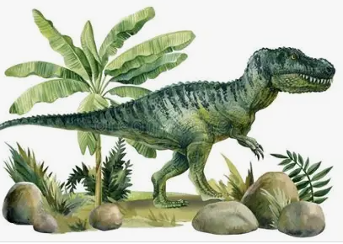



This year:
This is me
Frozen planet
dinosaurs
FARMS
PEOPLE WHO HELP US
CASTLES
Notes:
KT

Slide 6
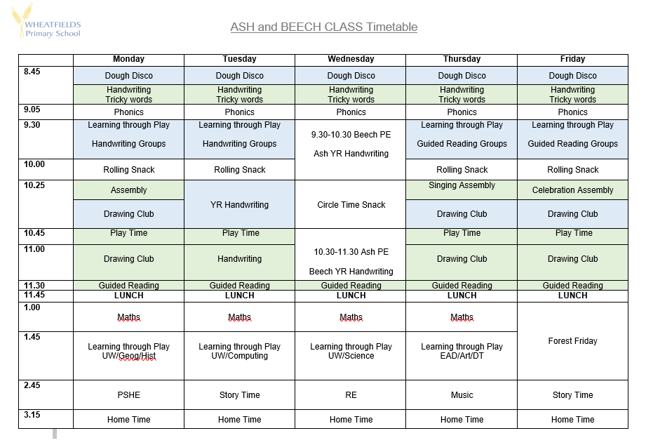
An example week
Notes:
KT

Slide 7

Phonics
We follow ‘Essential Letters and Sounds.’
All children do Phonics every day.
Workshop- 2nd October 2026 at 9.15am. For Reception Parents
Notes:
LJT

Slide 8
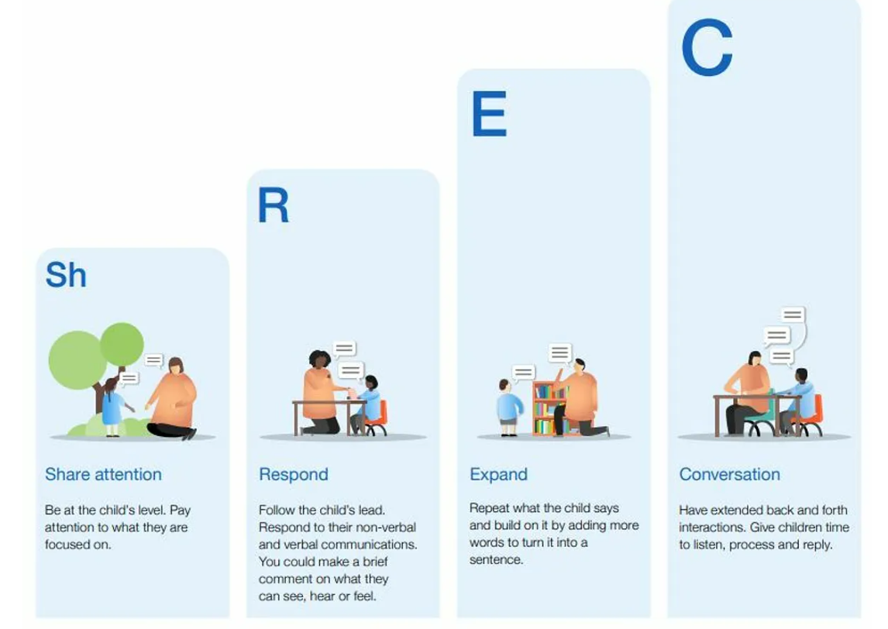
GOOD TALKING
Notes:
KT
Developing speaking and listening is a whole school priority this year
During LEAD we will be focusing on developing communication through sharing attention, responding to what they say both verbally and non verbally, expand- turn it into a sentence and ultimately developing a two-way conversation.

Slide 9

DRAWING CLUB
Notes:
KT
How we are going to teach English in Sapphire Class
1 book, traditional tale or animation a week.
Learn lots of vocabulary
Develop fine motor skills through drawing
Start with mark making and develop into writing throughout the year.
Includes maths
It allows the children to develop their imagination too.
Daily

Slide 10
Physical activities
PE is on a Wednesday.
Children come to school in their PE kit.
Earrings must be removed.
Forest School is on a Friday.
Please provide waterproof jackets and trousers for children to wear over their school uniforms for outdoor learning.
If your child does not already have wellies in school, please send some in.
Notes:
LJT

Slide 11


We will communicate with you about things that are happening in class via Class Dojo.
Make sure your account has been activated.
Please post some of the exciting things that you have been doing at home for us to see in the chat.
Home learning…
Notes:
LJT

Slide 12
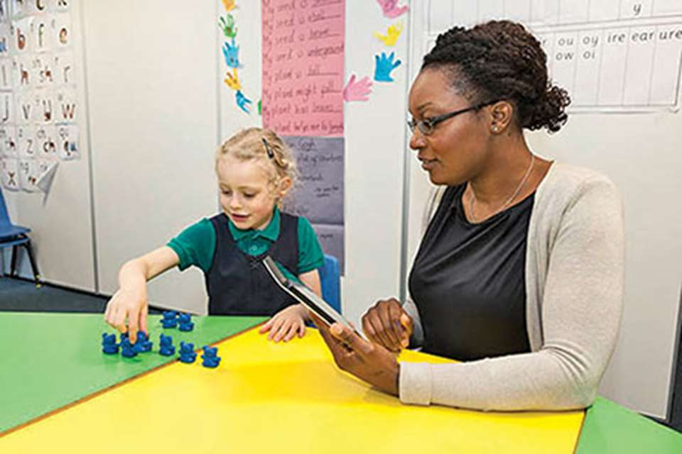
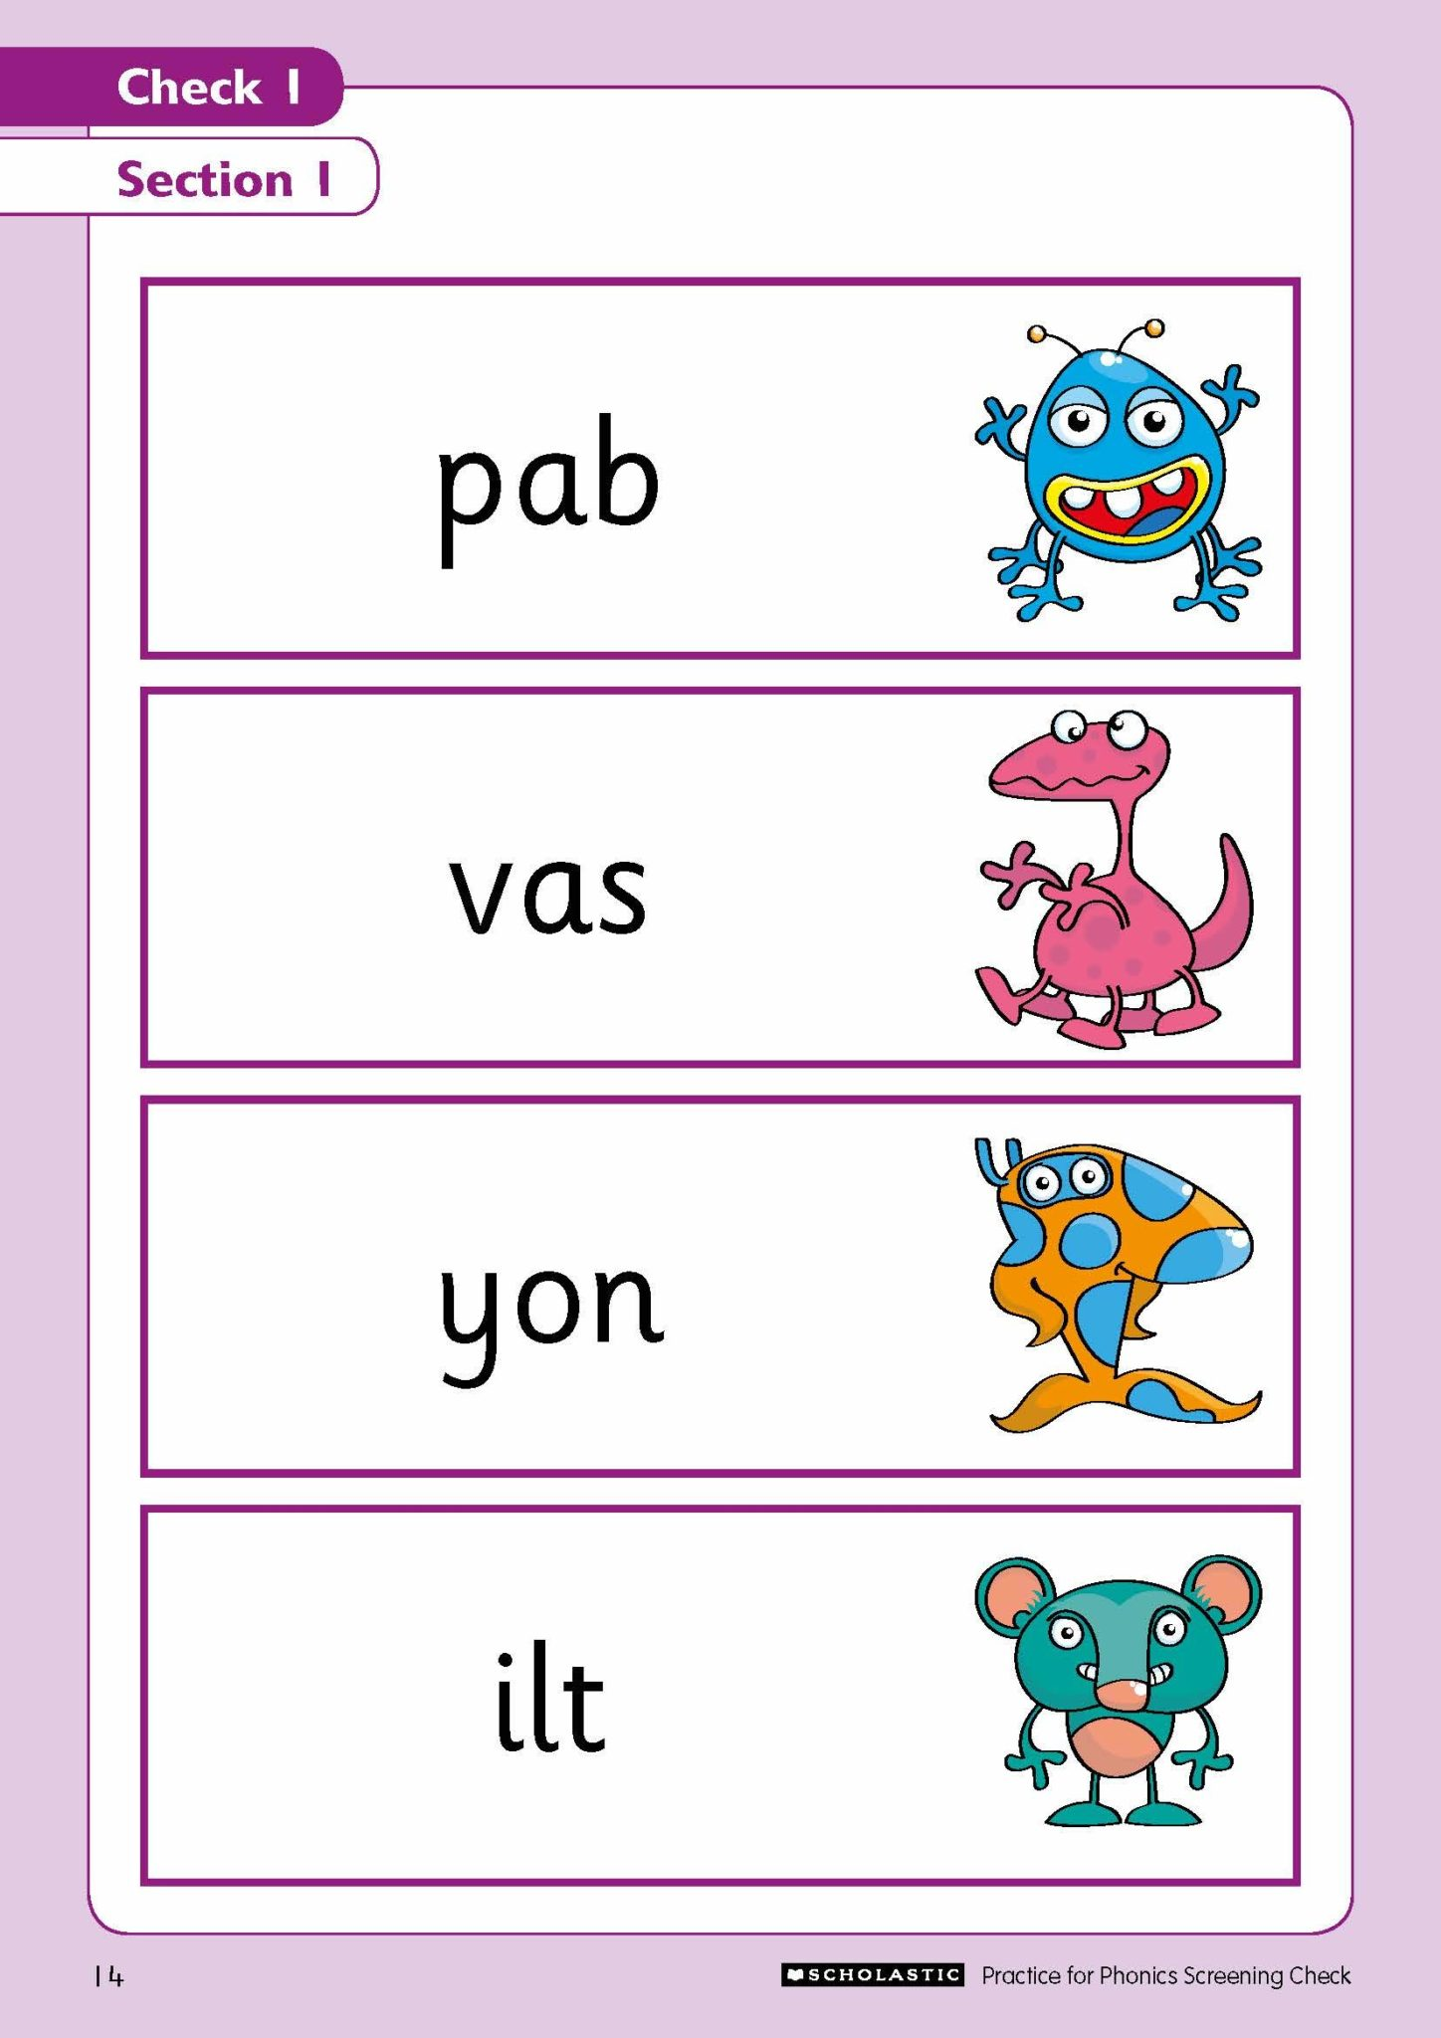
Statutory assessments
Reception Baseline Assessment
Early Years Foundation Stage Profile
Year 1 Phonics Screening Check
Notes:
NJ

Slide 13
Things to note…
Wellies
Coats/Jackets/Jumpers- independence
Name all items of clothing
Pre existing injuries
Notes:
KT
Please let us know if your child has sustained an injury at home
Communication- about progress parent’s evenings, end of year report. If we have any concerns we will contact you- assume no news is good news! If you have any questions we are available at the end of the day.

Slide 14

Any questions

