Slide 1
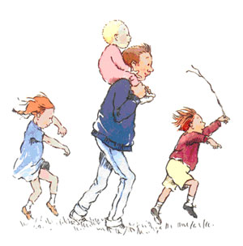
We’re going on a bear hunt
Number bonds to 10

Slide 2
If the children saw 2 bears then
how many more would they
Need to see to find 10?
8

Slide 3
If the children saw 4 bears then
how many more would they
Need to see to find 10?
6

Slide 4
If the children saw 3 bears then
how many more would they
Need to see to find 10?
7

Slide 5
If the children saw 6 bears then
how many more would they
Need to see to find 10?
4

Slide 6
If the children saw 5 bears then
how many more would they
Need to see to find 10?
5

Slide 7
If the children saw 8 bears then
how many more would they
Need to see to find 10?
2

