Slide 1
Year 2 Curriculum meeting 2021

Slide 2
Year Two team
Teachers:
Mrs Gray-Thomas
Mrs Cleghorn
Mrs Vickers
Learning Support Assistants:
Mrs Kusar
Mrs Wetherfield
PPA cover on Wednesday afternoons:
Mrs Redding
Mrs Barker

Slide 3
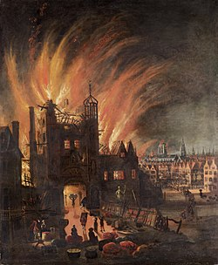
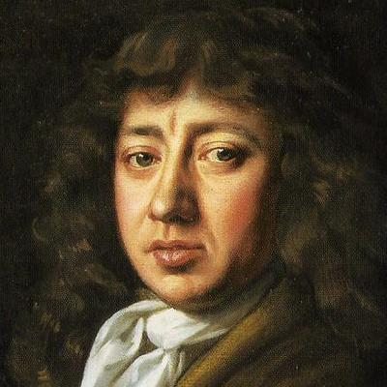
What are we learning?
Autumn 1: Emergency!

Slide 4
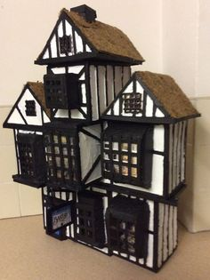
Design and make afternoon
Friday 15th October
1.15pm – 2.50pm
Bring in your own materials to make a Tudor house with your child.

Slide 5
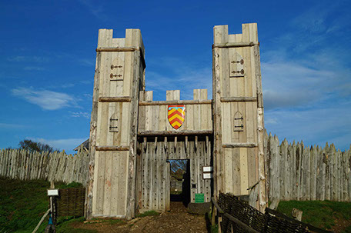
What are we learning?
TRIP!
Friday 5th November!
Autumn 2: A long time ago…

Slide 6
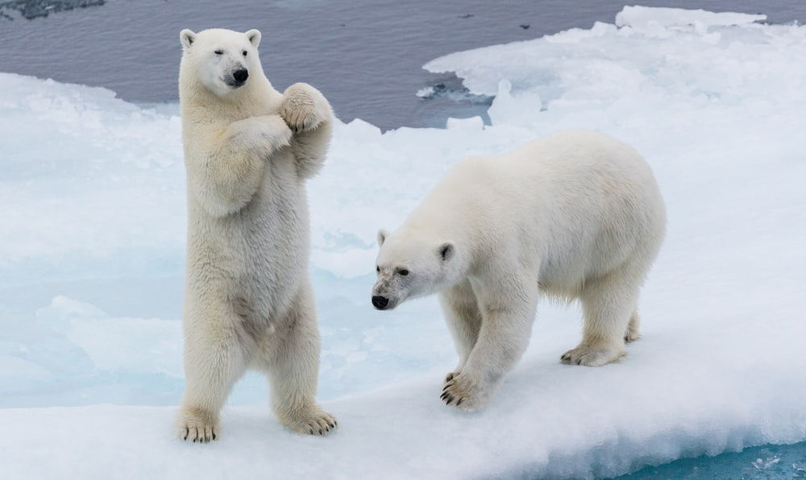
What are we learning?
Spring 1: Frozen Planet

Slide 7
What are we learning?
Spring 2: In a place far, far away…

Slide 8
What are we learning?
Summer 1: Green Fingers

Slide 9
What are we learning?
Summer 2: Away we go!

Slide 10
P.E
Monday and Tuesday afternoons PE kit
Indoor PE: dark shorts and a white t-shirt.
Outdoor PE: long jogging bottoms, a white t-shirt and a black or navy jumper.
Children must have a change of shoes for PE – trainers are ideal to support the ankle.
PE kits will stay in school until every half term. Please wash them over half term and return them the day we come back to school!

Slide 11
Learning behaviours – 5 R’s
Resilience
We try hard!
Resourcefulness
Use things that help us learn!
Reciprocity
We learn together!
Respect
Treat others as you would like to be treated!
Reflectiveness
We learn from our mistakes!

Slide 12
Behaviour and expectations
Golden Rules
Classroom Rules
Finishing time

Slide 13
Rewards
Head Teacher’s Awards
Good Manners Tea Party
House points
End of year KS1 trophy

Slide 14
Reading in Year Two
Ten minutes per night (minimum)
Sharing reading with your child
Developing understanding and asking questions
Discussion – book talk

Slide 15
How to get in touch with us
Orange Communication Books or Class Emails
Easy communication between home and school
Important information
Questions and queries
Good news and positive praise
After school arrangements
If your child is going home with someone different to their normal routine, please inform us by writing this in their communication book.

Slide 16
Home learning
Reading (daily)
Mathletics, Readiwriter or TTRockstars
Home learning menu

Slide 17
Recommended online activities School website > Parent Pages > Home Learning Programmes
SPELLING PROGRAMME:
https://login.readiwriter.com/
LITERACY:
http://www.wordsforlife.org.uk/
MATHS:
https://login.mathletics.com/
https://ttrockstars.com/login
BUSY THINGS LEARNING:
https://www.busythings.co.uk/play/
OTHER:
https://www.bbc.co.uk/bitesize
Number blocks on BBC iPlayer

Slide 18
Phonics Check 2021
They inform our Teacher Assessment
This takes place over a week
The children will read ‘real words’ and ‘pseudo words’

Slide 19
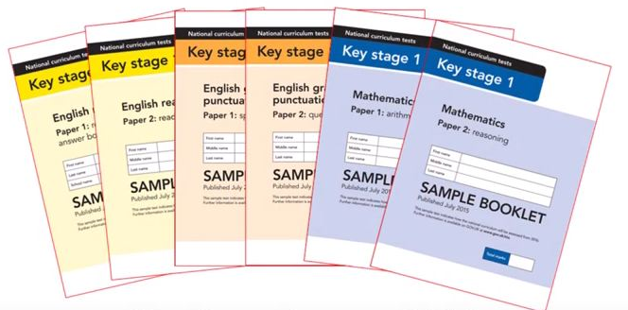
SATs – May 2022
They inform our Teacher Assessment that is reported to you at the end of the year
No term-time holidays during this time!
Two reading papers
Two maths papers
Two GPS papers
Meeting in Spring term for more details

Slide 20
What we need every morning
Reading record
Communication book
Water bottle
Hat (for those rare sunny days)

Slide 21
KS1 Snacks
Children are provided with a snack. We have a variety on offer each week.
Apples, bananas, raisins, pears, carrots and tomatoes have been on offer since returning to school.
Please do not bring in your own snacks, unless there are any dietary requirements we need to be made aware of!

Slide 22
In your child’s book bag tonight
Copy of presentation
Questions to ask your child when reading
Common exception words – your child should be able to read AND spell these words
Log-ins for online learning at home (stuck in Reading Records)

Slide 23
Final notes
Parent helpers
PAWS
Design and Make afternoon – Friday 15th October
Year Two trip to Mountfitchet – Friday 5th November

Slide 24
Any questions?

