Slide 1
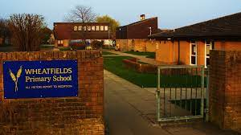
Welcome to Year 4

Slide 2
The Year 4 Team
Larch Class - Miss Davies
Maple Class- Mrs Tudor
L.S.A.s Mrs Kusar, Mrs Cutbush, Mrs Kynoch
PE – Miss Charlotte / Mr Puckey

Slide 4
The Curriculum
Autumn – ‘Tuesday’ by David Wiesner, ‘The Lost Happy Endings’ by Carol Ann Duffy, Forces and magnets, Sound, Europe and map work
Spring – States of Matter, Anglo-Saxons and The Vikings and Viking Science
Summer – ‘Iron Man’ by Ted Hughes, Habitats and Electricity, the local area

Slide 5
Reading
Reading at home - daily
Reading Diaries-completed daily
Visiting school library
Accelerated Reader (AR)

Slide 6
Spellings
Year 3 and 4 Statutory spelling list
Encourage the children to use different strategies
Readiwriter to support

Slide 7
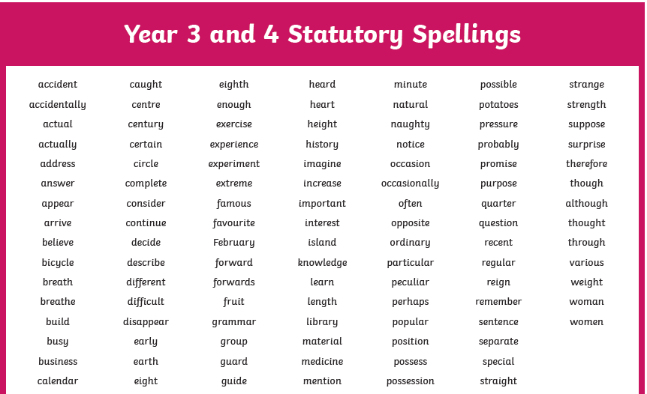
Spellings
The words can be found in their reading record books.

Slide 8
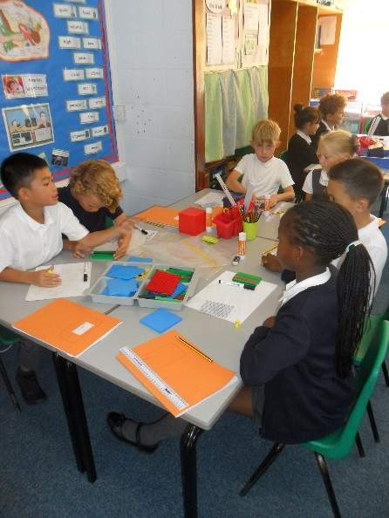
Maths
The importance of learning multiplication tables and number bonds
Whole class teaching
New Year 4 Multiplication Tables Check
Mathletics and Times Tables Rock Stars

Slide 9
Handwriting Opportunity to earn a pen licence

Slide 10
Home Learning
Home Learning Menu –half termly
Reading Daily and signed in Reading Records
Multiplication tables/division practice

Slide 11
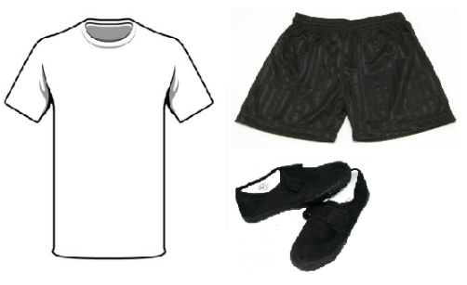
Uniform and Sports Kit
Games – Mondays and Wednesdays
Suitable kit
No jewellery
Change of shoes
Hair tied back
Uniform and kit needs
to be labelled

Slide 12
The 5 Rs Being Independent Learners
Resilience
Resourcefulness
Reflectiveness
Reciprocity
Respect

Slide 13
Trips and Visits
Thorpe Woodlands
Viking Day

Slide 14
Communication
Class emails
Mrs Tudor: mapleclass@Wheatfields.cambs.sch.uk
Miss Davies: larchclass@Wheatfields.cambs.sch.uk

