Slide 1
Year 2 Curriculum meeting 2019
Miss Crellin and Mrs Cleghorn

Slide 2
Year Two team
Teachers:
Miss Crellin
Mrs Cleghorn
Learning Support Assistants:
Mrs George
Dr McCabe
Mrs Sitnikova
Mrs Kausar
Mrs Maloney
Mrs Buck
PPA cover on Thursday afternoons:
Mrs Verney-Davies
Mrs Tucker

Slide 3
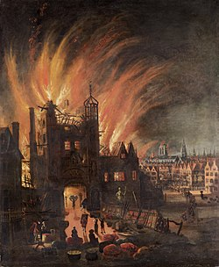
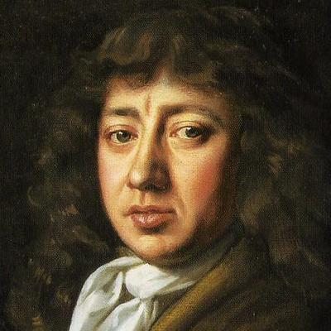
What are we learning?
Autumn 1: Emergency!

Slide 4
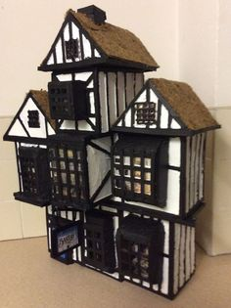
Design and make afternoon
Friday 11th October
1.15pm – 2.50pm
Bring in your own materials to make a Tudor house with your child.

Slide 5
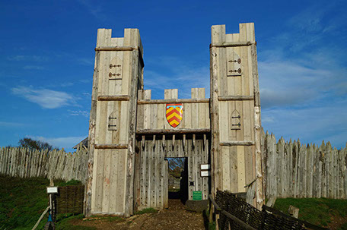
What are we learning?
Autumn 2: A long time ago…
TRIP!

Slide 6
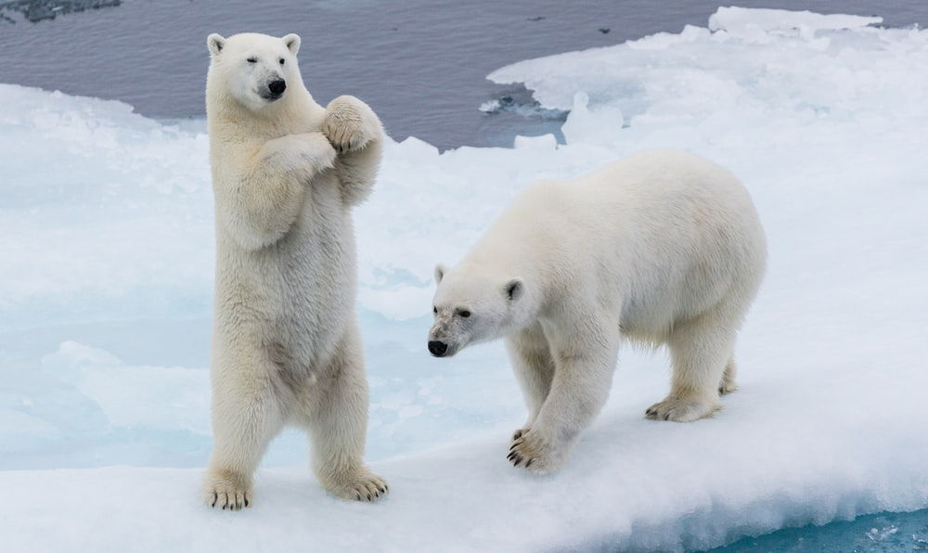
What are we learning?
Spring 1: Frozen Planet

Slide 7
What are we learning?
Spring 2: In a place far, far away…

Slide 8
What are we learning?
Summer 1: Green Fingers

Slide 9
What are we learning?
Summer 2: Away we go!

Slide 10
P.E
Wednesday and Friday afternoons PE kit
Indoor PE: dark shorts and a white t-shirt
Outdoor PE: long jogging bottoms, a white t-shirt and a PE jumper.
Children must have a change of shoes for PE – velcro plimsoles are ideal.

Slide 11
Learning behaviours – 4 R’s
Resilience
We try hard!
Resourcefulness
Use things that help us learn!
Reciprocity
We learn together!
Reflectiveness
We learn from our mistakes!

Slide 12
Behaviour and expectations
Golden Rules
Classroom Rules
Finishing time

Slide 13
Rewards
Head Teacher’s Awards
KS1 Celebration Assembly
Good Manners Tea Party
House points
Finishing time

Slide 14
Reading in Year Two
Ten minutes per night (minimum)
Sharing reading with your child
Developing understanding and asking questions
Discussion – book talk

Slide 15
Home school communication books
Easy communication between home and school
Important information
Questions and queries
Good news and positive praise
After school arrangements
If your child is going home with someone different to their normal routine, please inform us by writing this in their communication book.

Slide 16
Home learning
Reading (daily)
Mathletics
Half-termly projects
Possibly GPS, maths and phonics practise

Slide 17
Recommended online activities School website > Parent Pages > Home Learning Programmes
SPELLING PROGRAMME:
http://www.3plearning.com/uk/spellodromeforparents/
LITERACY:
http://www.wordsforlife.org.uk/
MATHS:
http://uk.mathletics.com/signin/
http://www.familymathstoolkit.org.uk/ https://ttrockstars.com/login
BUSY THINGS LEARNING:
https://www.busythings.co.uk/play/
OTHER:
https://www.bbc.co.uk/bitesize

Slide 18
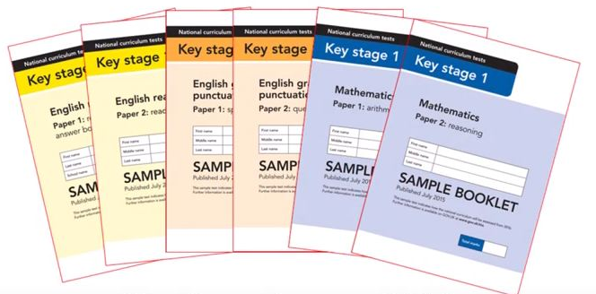
SATs – May 2020
They inform our Teacher Assessment that is reported to you at the end of the year
No term-time holidays during this time!
Two reading papers
Two maths papers
Two GPS papers
Meeting in Spring term for more details

Slide 19
Phonics
June 2020 re-test
Interventions and support

Slide 20
In your child’s book bag tonight
Copy of presentation
Questions to ask your child when reading
Common exception words – your child should be able to read AND spell these words
Log-ins for Mathletics (stuck in Reading Records) – more log-ins to come!

Slide 21
Final notes
Parent helpers
PAWS
Design and Make afternoon – Friday 11th October
Parent Consultations - Wednesday 16th and Thursday 17th October
Year Two trip to Mountfitchet – Friday 8th November

Slide 22
Any questions?

